Slide 1
Luteal Phase Support
SIG Endocrinology 2019
Chairperson – Madhuri Patil

Slide 2
Luteal phase reflects the functional lifespan of the corpus luteum Baird et al., 1975
Luteal phase is defined as the period from occurrence of ovulation until the establishment of a pregnancy or the resumption of menses 2 weeks later
Corpus Luteum
Formed from the remnants of the ruptured follicle
A major source of steroid hormones and secretes up to 40 mg of P4 per day Devoto et al., 2009
Temporary endocrine gland Life duration: 14 ± 2 days

Slide 3
Luteal progesterone rise important as it
Down-regulates the number of ERs, thus indirectly suppressing the inhibitory effects of E2 on integrins
Acts positively by increasing paracrine stromal factors - EGF and HB-EGF
Somkuti et al., 1997
Direct effect stimulate homeobox gene HOXA 10 - implicated in the regulation of ß3 subunit expression (Lessey, 2003)
THUS ----
Progesterone plays critical role in implantation and development of normal pregnancy

Slide 4
Inadequate Functioning of Corpus Luteum
Decreased
Progesterone
levels
Decreased Duration Progesterone Secretion
Decreased Number of Nuclear Progesterone Receptors in the Endometrium
INCID Infertility fact sheet Luteal phase defect 1999,
Jacobs M et al J of Cli Endo & Meta 1987,64 (3) : 472

Slide 5
LP Insufficiency can occur in
Natural cycle
CC/AI stimulated cycles
GT cycles with or without GnRH analouges

Slide 6
Why does LPD occur in Natural Cycle?
Hypothalamic Ovarian Endometrium
Pituitary
Faulty E2/P
Receptors
Endometrium not prepared properly
Abnormal
FSH & LH
Faulty /deficient
LH/FSH receptors
In Endometrium
Hyperpro- lactinaemia
CL Dysfunction
Aberrant
folliculogenesis
Progesterone production
Infertility/ Recurrent abortion

Slide 7
Causes for LPD in Clomiphene Citrate stimulated cycles
CC occupies the hypothalamic E2 receptors for several weeks resulting in receptor downregulation which induces P4 receptors block
Markedly high luteal E2 levels with abnormal E2/P4 ratio
Glandular stromal dyssynchrony
Leutolytic effect on corpora lutea
Anti-estrogenic effect on endometrium
Dickey et al., 1996, Van steirteghem et al., 1988 and Tavaniotou et al., 2003

Slide 8
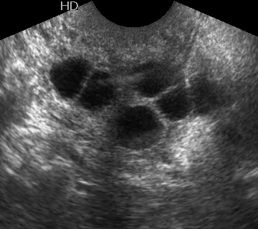
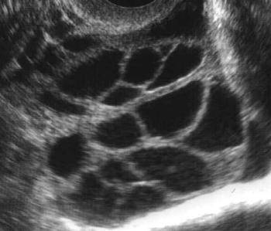
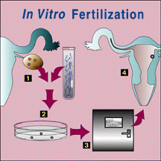
Causes for LPD in Gonadotrophin stimulated cycles
Decreased LH levels by different mechanisms LPD
1.Supraphysiological concentrations of E2
Result in deficient LH in the luteal phase
2.Use of GnRH agonist and antagonist
Suppress LH
3.hCG via short-loop
Suppress LH?
4.In ART cycles
Oocyte retrieval?
Removal of granulosa
Shorter luteal phase
Edwards et al. 1980, Fatemi et al, 2007J Clin Endocrinol Metab 88: 4186–4192, 2003

Slide 9
Luteal Phase Support in IUI
Required
Definitely with use of
Gonadotrophins
AND
GnRH analogs - Agonist and Antagonist
Given empirically
In most natural and CC cycles
To Increase the success rate

Slide 10
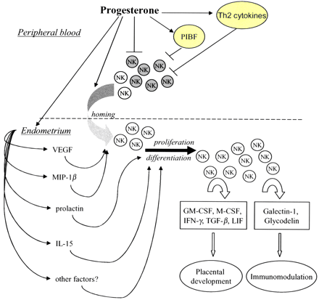
Endometrium sensitive to decreased steroid levels
and
Altered E2/P4 ratio
Both E2 and P4 play crucial role in implantation
Given empirically because
Associated with delayed endometrial maturation & reduced endometrial receptivity
Subnormal mid luteal E2 and P4 concentrations in COS cycles

Slide 11


Luteal phase support in ART
LPS is definitely indicated in IVF treatment cycles

Slide 12
Luteal Phase Support
Progesterone
Oral
Vaginal/ Rectal
hCG
1500 IU every 3rd day for 3-4 doses
Oral 4 -6 mg per day in divided doses
IM
50/100mg
Per day
Estrogen
GnRH agonist
Transdermal Estradiol gel -2.5 mg gel containing 1.5 mg estradiol twice a day
SC aqueous 25 mg daily
Dydrogesterone
10 mg twice a day
Micronized P4 600 - 800 mg Per day in divided doses
P4 gel 8%
90 mg once/day
Micronized P4 800 mg Per day in divided doses
0.1 mg of GnRH agonist (triptorelin)
On Day 6 of OR

Slide 13
Personalized Luteal Phase Support
with GnRHa trigger
Supplementing with one bolus of 1500 IU hCG on the day of OPU in addition to standard LPS with vaginal P4 and oral estradiol
3 doses of 500 IU of hCG as LPS Safe and efficient alternative in high-responders
Rec LH for 10 days from day of OPU
5000 – 30000 IU
10000 IU adequate but ideal dose
needs to be evaluated
Freeze all embryos with transfer in subsequent HRT cycle

Slide 14
LPS after GnRH agonist Trigger
American Approach
50 mg IM progesterone daily + 0.3 mg transdermal E2 patches on alternate days and continued until 10 weeks gestation
E2 and P4 levels are monitored on days 3 and 7 of OR
European approach
1500 IU of HCG administered 35 hours after GnRH agonist trigger or after OR followed by standard LPS
IM P4 dose is increased to 75 mg daily if serum P <20 ng/mL
Transdermal E2 patches is increased to a maximum of 0.4 mg with oral micronized E2 added to maintain serum E2 >200 pg/mL
32

Slide 15
Adjuvants in Luteal Phase
Use of
Aspirin
LMW Heparin
Sildenafil
Prednisolone
Ascorbic Acid
IV Ig
G-CSF
Intralipid
Remains controversial
Empirical treatment with LMWH, aspirin, ascorbic acid, sildenafil or corticosteroids has no evidence for use in women who were negative for thrombophilic tests, may be used in women with RIF

Slide 16
When to start progesterone?
Is TIMING relevant?
Administration of P4 before OR associated with a lower PR due to premature secretory changes in the endometrium therefore IR
Decrease in PRs by 24% was seen when LPS was delayed until 6 days after OR compared to 3 days after OR
No difference was found when LPS was started at OR compared to within 24 – 48 hours after

Slide 17
Luteal Phase support
For how long????
Usually given till 8 weeks, when the placenta takes over the function of producing hormones
(Costabile et al, 2001)
Up to 12 weeks (Check et al, 1991)
But according to ASRM guidelines, there is no proven role in adding P4 or hCG for luteal support once a pregnancy has been established
Stelling et al, 1999; Penzias,2002; Jacobs & Balen,2003, Andersen et al. Hum Reprod 2002 Elena H. Yanushpolsky; 2015
Use of supplemental P4, in a non-ART cycle beyond the time of expected menses (i.e., 2 weeks after ovulation), is not proven beneficial
Recent RCT: no benefit after 1st ultrasound
Aboulghar et al. Hum Reprod 2008; Kyrou et al. Hum Reprod 2011; Kohls et al. Fertil Steril 2012

Slide 18
Take home messages
In COS luteal endocrinology and endometrium is complicated by possible effects of pituitary down-regulation with GnRH analogues
use of HCG or GnRHa to trigger oocyte maturation
Endometrium is subject to altered endocrinological environment due to supra-physiological steroid levels which are responsible for impaired implantation
LPS is essential in all ART cycles and those Non-ART OI cycles, which use GT and GnRH analogues

Slide 19
LPS improves PRs of IUI only in GT cycles and not in natural or CC cycles
IUI
Significant effect in favor of P4 for LPS
ART
Addition of GnRHa to P4 appears to improve outcomes
ART
No evidence favoring a specific route or duration of administration of P4
IUI & ART
Addition of E2 or hCG to P4 did not improve outcome
ART
hCG or hCG plus P4 associated with higher risk of OHSS hence, should be avoided
ART
P4 levels > 15ng/ml in luteal phase of stimulated cycle appear to reduce EPL and IR
IUI & ART
Conclusion

